Slide 1


CAPSTONE PROJECT
LAKSHYA
Student Success Analytics
Presented By
Student Name: DULAM VIGNESH
College Name: MALLA REDDY COLLEGE OF Engineering and technology
Department: computer science and engineering
Email ID: dulamvignesh2004@gmail.com

Slide 2
OUTLINE:
Problem Statement
Proposed System/Solution
System Development Approach (Technology Used)
Report and Analysis
Result (Output Image)
Conclusion
Future Scope
References

Slide 3
Problem Statement:
Educational institutions collect extensive student data such as academic scores, attendance, and skill assessments, but this data is often not effectively analyzed to generate actionable insights. As a result, identifying students at risk of poor performance or dropout becomes challenging. Additionally, the lack of structured analysis limits the ability to provide effective academic and career guidance. A data-driven analytical approach is therefore required to visualize student performance trends, identify potential risks, and support better decision-making.

Slide 4
Proposed Solution:
The proposed system, Lakshya – Student Success Analytics Dashboard, transforms raw student data into meaningful insights using data analytics and interactive Power BI visualizations. The system helps educational institutions monitor student performance, identify potential dropout risks, and support effective academic and career guidance.
Key Components:
Data Collection
Collect student data such as academic scores, attendance, skills, engagement levels, and demographic information.
Data Preparation
Clean and organize the dataset to handle missing values and categorize data into departments, score ranges, and attendance groups.
Data Analysis
Analyze relationships between attendance, academic performance, skills, and engagement to identify patterns and potential risks.
Dashboard Development
Build an interactive Power BI dashboard with visual insights including:
Executive Overview
Academic Performance & Skills Analysis
Dropout Risk & Career Insights
Interactive Insights
Use filters and slicers to allow users to explore data dynamically and support data-driven decision making.
Result
A visual analytics dashboard that helps institutions track student performance, detect at-risk students, and improve academic guidance.

Slide 5
System Approach:
The system approach describes the methodology used to develop the Lakshya – Student Success Analytics Dashboard using data analytics and visualization techniques.
System Requirements
Microsoft Power BI Desktop
Student dataset (CSV/Excel format)
Basic system with Windows OS and internet connectivity
Tools & Technologies Used
Power BI for data visualization and dashboard creation
Power Query for data cleaning and transformation
DAX (Data Analysis Expressions) for creating measures and calculations
Dashboard Development Process
Import and preprocess the dataset in Power BI
Create relationships and calculated measures
Design interactive charts, graphs, and filters
Build multiple dashboard pages for analysis and insights

Slide 6
report & analysis:
The Lakshya – Student Success Analytics Dashboard analyzes student data to generate meaningful insights about academic performance, attendance, skills, and dropout risk.
Key Analysis Performed:
Student Distribution Analysis Visualizes the number of students across different departments and gender categories.
Academic Performance Analysis Examines academic score distribution and performance trends across semesters.
Attendance vs Performance Relationship Identifies how student attendance impacts academic performance.
Skill & Engagement Analysis Evaluates skill levels and engagement patterns across departments.
Dropout Risk Analysis Detects students with higher dropout risk based on attendance and performance indicators.
Career Recommendation Insights Analyzes career path recommendations based on student skills and department trends.
Outcome: The dashboard provides interactive insights that help educators and institutions make data-driven decisions to improve student success and academic guidance.

Slide 7
Result:
The Lakshya – Student Success Analytics Dashboard successfully analyzes student data and presents meaningful insights through interactive visualizations using Microsoft Power BI.
The dashboard provides a comprehensive view of student performance, attendance patterns, skill levels, and dropout risk indicators.
Key Results:
• Total students analyzed: 1000 • Average academic score: 66.94 • Average attendance: 71.43% • High-risk students identified: 464
The dashboard includes multiple analytical views such as:
• Executive Overview – Displays overall student statistics and key performance indicators. • Academic Performance & Skills Analysis – Shows relationships between attendance, performance, and engagement levels. • Dropout Risk & Career Insights – Identifies at-risk students and highlights recommended career paths.
The interactive filters and visualizations allow users to explore the data dynamically and gain insights that support data-driven academic decision-making.

Slide 8
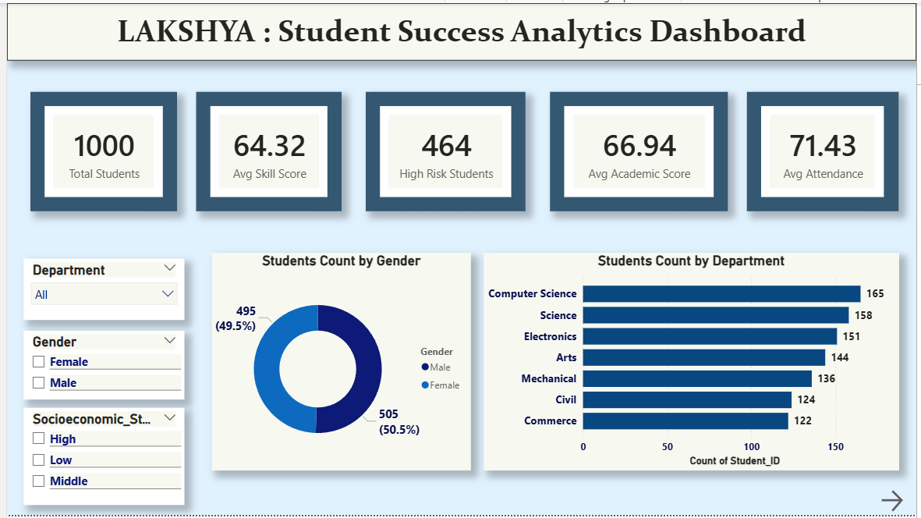
Result:
Fig 1(a) : Page 1

Slide 9
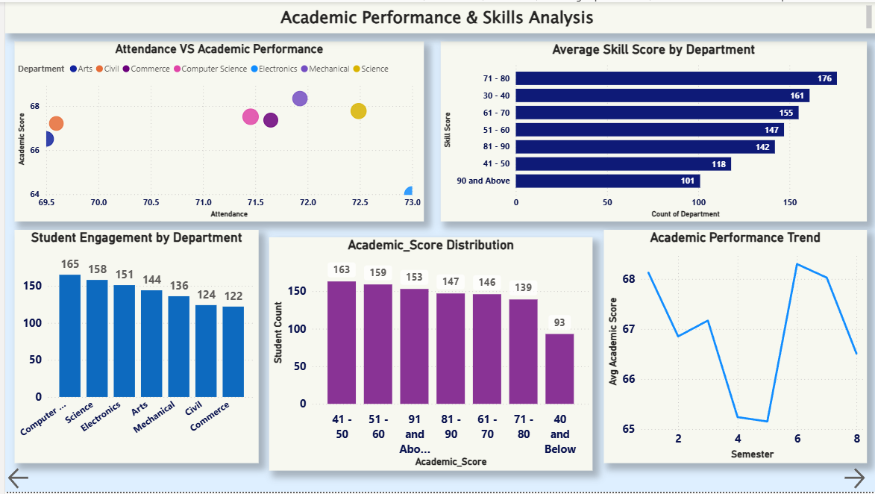
Result:
Fig 1(b) : Page 2

Slide 10
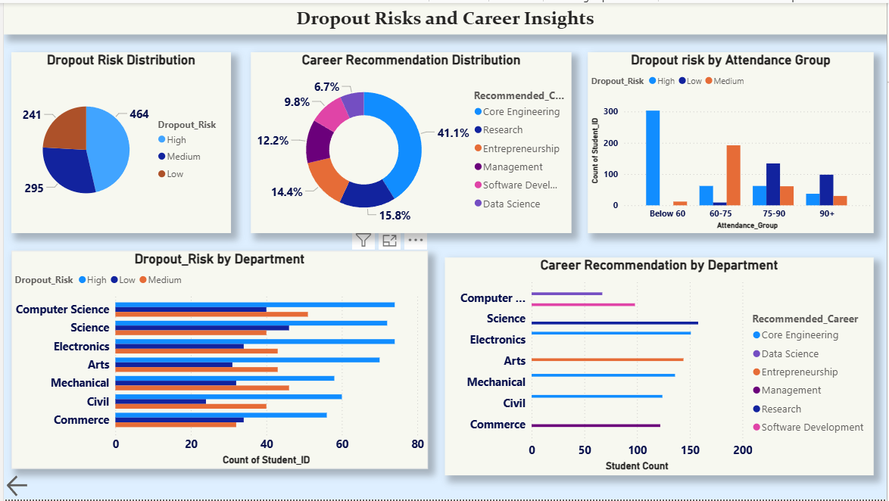
Result:
Fig 1(c) : Page 3

Slide 11
Conclusion:
The Lakshya – Student Success Analytics Dashboard demonstrates how data analytics and visualization can transform raw student data into meaningful insights. By analyzing factors such as academic performance, attendance, skills, and engagement levels, the dashboard helps identify patterns that influence student success.
The interactive Power BI dashboard enables institutions to monitor student performance, detect potential dropout risks, and understand career recommendation trends. Through clear visualizations and dynamic filters, educators and administrators can easily explore the data and gain valuable insights.
Overall, the system supports data-driven decision-making, helping educational institutions improve academic guidance, enhance student engagement, and promote better student outcomes.

Slide 12
Future scope:
The Lakshya dashboard can be further enhanced by incorporating additional data sources and advanced analytics techniques to improve the accuracy and depth of insights.
Possible future improvements include:
Integrate real-time student data for continuous performance monitoring.
Apply machine learning models to predict student success and dropout risk.
Provide personalized career and course recommendations based on student skills.
Develop a web or cloud-based dashboard for easier access across institutions.
Include additional factors like student activities, feedback, and engagement data for deeper insights.
These enhancements can make the system more intelligent and support better decision-making in educational institutions.

Slide 13
References:
[1] Microsoft Power BI Documentation – https://learn.microsoft.com/power-bi/
[2] Power BI Data Visualization Guide – Microsoft Learn
[3] Educational Data Mining and Learning Analytics Research Articles
[4] Data Analytics and Visualization Best Practices
[5] Dataset created for academic analysis and visualization purposes
GitHub Link: https://github.com/DulamVignesh/Lakshya-Student-Success-Analytics.git
Google Drive Link:
https://drive.google.com/drive/folders/1u1i5TWH_he9Ny1CLAy5biMvtrTjWbc2?usp=sharing

Slide 14
Thank You

